Slide 1
1-3 Segments, Rays, Parallel Lines and Planes
M11.B.2, 2.5.11.B
Objectives: 1) Identify segments and rays
2) Recognize parallel lines

Slide 2
Vocabulary
Segment- is the part of a line consisting of two endpoints and all points between them
Ex)
Ray- is the part of a line consisting of one endpoint and all the points of the line on one side of the endpoint
Ex)
Endpoint
Endpoint
A
B
.
.
.
.
A
B
AB
Endpoint
AB
**Must start with endpoint when naming a ray**

Slide 3
Vocabulary
Opposite Rays – are two collinear rays with the same endpoint. Always form a line.
.
.
.
Q
R
S
RQ and RS are opposite rays

Slide 4
Example 1: Naming Segments & Rays
Segments:
Rays:
.
A
.
B
.
D
C

Slide 5
Ex. 2: Naming Segments and Rays
Name the segments and rays.
LP and PL form a line, are they opposite rays?
Which rays are opposite rays?
L P Q

Slide 6
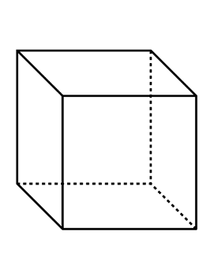
Vocabulary
Parallel Lines – Are coplanar lines that do not intersect
AB || EF
Skew Lines – Are noncoplanar, therefore, they are not parallel and do not intersect.
AB and CG are skew
D
C
A
B
H
G
E
F

Slide 7
Example: Identify Parallel & Skew Lines
Parallel to AB Skew to AB
F
G
E
H
B
C
A
D

Slide 8
Vocab
Parallel Planes – are planes that do not intersect.
Name two planes that are parallel.
Name a line that is parallel to BC.
Name a line that is parallel to plane BFGC
E
F
A
B
H
G
D
C

Slide 9
Example: Identifying Parallel Planes
Name all segments parallel to AD
Name all segments skew to AD
A
B
D
C
E
F
H
G

